Slide 1
Oil and Antifreeze Recycling in BC The Interchange Recycling Program

Slide 2
Stop Wishing. Start Recycling.

Slide 3
About Interchange Recycling
Formerly BC Used Oil Management Association
Not-for-profit organization
Dedicated to recycling lubricating oil, oil filters, oil containers, antifreeze, and antifreeze containers

Slide 4
Program Scope
Recycles approximately:
50 million liters of oil annually
6 million oil filters
3 million liters of antifreeze
1.7 million kilograms of plastic containers

Slide 5
Recycling Used Motor Oil
Link to Youtube
Link to Youtube

Slide 6
Collection Network
Located in:
High traffic retail locations
Industrial sites
Multi-material private depots
Local government recycling/landfill sites
288 recycling centers across BC

Slide 7
How It Works - Collection
94% from commercial facilities (service stations, lube shops, large operations)
6% from public recycling centers
Free drop-off for individuals at public centers
How it works video

Slide 8
The Recycling Process
Collectors pick up materials from generators and public centers
Materials delivered to registered processors
Processors prepare materials for reuse or sale as raw materials

Slide 9
What Happens to Recycled Materials?
Used motor oil: Re-refined into new lubricating oil or used in manufacturing/energy products
Oil filters: Metal recycled into products like rebar, nails, and wire
Containers: Recycled into new oil containers, drainage tiles, and parking curbs
Antifreeze: Refined into new automotive antifreeze

Slide 10
Environmental Impacts
Prevents pollution of water and soil and supports conservation of animal and plant biodiversity both on land and in water
Conserves non-renewable resources
Reduces CO2 emissions and supports zero waste initiatives

Slide 11
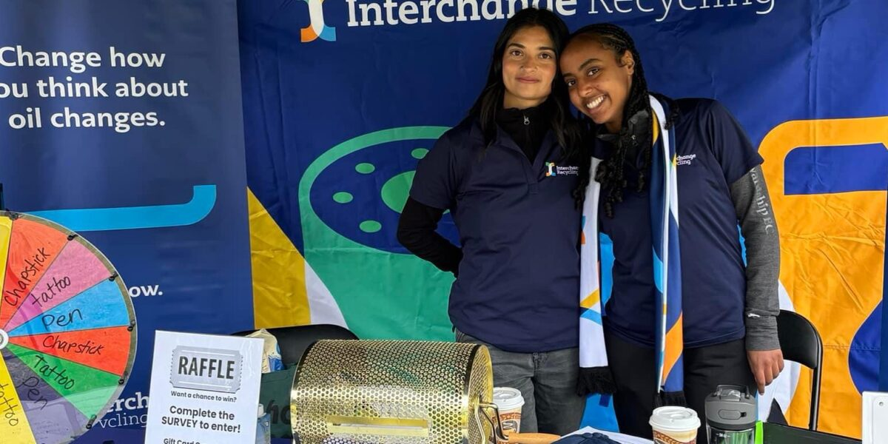
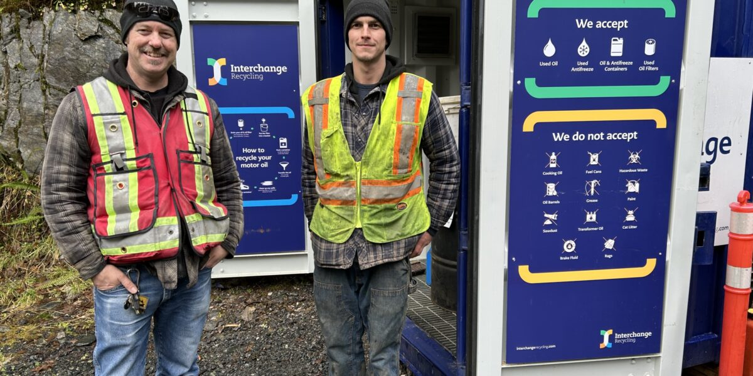
Economic Benefits
Supports local jobs in collection and processing
Contributes to a circular economy in BC
Cost-effective waste management for businesses and communities

Slide 12
Recycling oil and antifreeze: A simple act with a big impact on BC's environment and economy
interchangerecycling.com | dlawes@interchangerecycling.com

